Slide 1



StockX
Visualization and Forecasting of Stocks
BE COMPS ( DIV – B )
SURAJ NAIK 9274
HARSH PARMAR 9278
MEHUL PATEL 9279

Slide 2
Abstract
Demand of Stock have become huge with increased in popularity of Stock Digital World. Prediction and Analysing stock can benefit people to think before buying or selling stocks. So ,a new stock price prediction through Machine learning Algorithms will be analyzed and visualized. Through this system we can predict of any company in the world.

Slide 3
Introduction
As any one of us could guess, the market is unstable and, more than often, unpredictable. For several decades researchers have toyed with time-series data to predict future values – of which the most challenging and potentially lucrative application is predicting the values of stocks for a given company.
However, as expected, market change depends on many parameters of which only a bunch can be quantified, such as historical stock data, the volume of trade, current prices.
Of course, fundamental factors such as a company’s intrinsic value, assets, quarterly performance, recent investments, and strategies all affect the traders’ trust in the company and thus the price of its stock. Only a few of the latter can be incorporated effectively into a mathematical model.

Slide 4
Problem Statement
A person who has less experience in stock market mostly follows the following mantra, "buy low, sell high” but this does not provide enough context to make proper investment decisions. Before anyone invests in any stock, we need to be aware how the stock market behaves.
Investing in a good stock but at a bad time can have disastrous results, while investment in an average stock at the right time can bear profits. Inexperience people are facing this problem of trading as they do not properly understand as to which stocks to buy or which stocks to sell in order to get optimum profits.
Predicting long term value of the stock is relatively easy than predicting on day-to-day basis as the stocks fluctuate rapidly every hour based on world events.

Slide 5
Objectives
To learn and explore various machine learning algorithm.
To study and improve these algorithms to predict the stock price.
To Build an online system to predict the long term trend and short term trend of various stocks.
To build a user friendly web application that allows the users to view prediction results and visualize the trend.

Slide 6
Literature Survey

Slide 12
Literature Summary
As is known to all, stock prices reflect the quality of national economy. However, the multi-noise, non-linearity, high-frequency, and chaos of stock render stock forecasting one of the most difficult problems in time series. Nonetheless, stock forecasting still attracts increasing attention from scholars and investors owing to its importance.
The stock price forecasting has been a highly controversial topic in the past decades. Some researchers have proposed the random work theory, according to which, stock prices could not be forecasted using historical stock data . In other words, the stock prices are completely random time series and the forecasting accuracy of stock prices could not exceed 50%.

Slide 13
Research Gap
Using CNN with the same architecture on other datasets didn’t give as impressive precision for buy and sell.
It only considers the impact of stock price data on closing prices and fails to integrate emotional factors such as news and national policy into the forecast.
In multilayer perceptron, the number of total parameters can grow to very high (number of perceptron in layer 1 multiplied by # of p in layer 2 multiplied by # of p in layer 3…). This is inefficient because there is redundancy in such high dimensions.
In multilayer perceptron, the model functioning depends on the quality of the training.
LSTMs get affected by different random weight initialization and hence behave quite similar to that of a feed-forward neural net. They prefer small weight initialization instead.
LSTMs are prone to overfitting due to this it is difficult to apply the dropout algorithm.

Slide 14
Requirements
Hardware Requirements:
RAM: 4 GB
Storage: 32 GB
CPU: 2 GHz or faster
Architecture: 32-bit or 64-bit
Software requirements:
Python 3.5 is used for data pre-processing, model training and
prediction.
Operating System: windows 7 and above or Linux based OS or MAC OS
Javascript,Html5,Css for creating the website which will host the entire model.

Slide 15

Theoretical Analysis
RNN (Recurrent Neural Network)
Time series prediction: RNNs can be trained on historical stock prices to predict future prices. The RNN can take into account the sequential nature of the data, including factors such as trends, seasonality, and cyclicality.

Slide 16
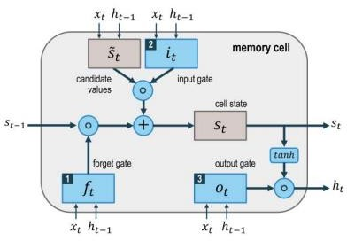
LSTM (Long-short Term memory)
Recurrent neural networks (RNNs) of the Long Short-Term Memory (LSTM) type have been extensively used to predict stock prices. LSTM can successfully address the vanishing gradient issue that typical RNNs encounter and can capture long-term dependencies in time series data.

Slide 17
Design and Methodology
Interface module:
Description and Priority-
This feature allows personnel to view the application. In general, the response of a web interface module should be designed to provide feedback to the user, indicating whether their input was successful, and if not, why it failed. This is an important feature, so it has high priority.
Stimulus/response sequences
Users first click on a button or link to start the registration process. The system then prompts the student to fill in their first name, last name, email address and password. Students enter the field. The system will verify the user data and a new account is created for students.

Slide 18
Administrator module:
Description and Priority:-Computer servers and Networks are supported and maintained by administrators
Functional requirements
REQ-1: Separate login.
REQ-2: To login as normal users, master password and ID is required.
REQ-3: Tools for implementing automated software solutions.
REQ-4: Tools for replacing hardware and software components.
Preprocessing module:
Description and Priority Data preprocessing involves looking for missing values, looking for categorical values, splitting the dataset into a training and testing set, and finally performing feature scaling to reduce the range of variables.

Slide 19
Data collection module:
Description and Priority:-It generally deals with composing the right data set. The data set to be used in market
forecasting must be used to filter grounded on varied aspects. Data collection also complements the data set by adding fresh data that's external. Our data consists substantially of stock prices from the former time. We'll originally dissect the Kaggle data set and according to the accurateness, we will use the model with the data to directly the forecasts can be analyzed.

Slide 20
Implementation
Creating LSTM Model
Libraries used for the implementation are as follows:
Pandas:
Data manipulation and dissection is quick and efficient.
It is possible to load data from different file objects.
Both Data Frame and advanced dimensional objects allow for the fitting and deletion of size mutability columns
Including and joining a data collection.
Pivoting and flexible reconfiguration of data collections.
Provides capability for time series.
Important group by features for splitting, applying, and combining data sets

Slide 21
Keras:
User-Friendly and Fast Deployment
Quality Documentation and Large Community Support
Pretrained models
Multiple Backend and Modularity
Streamlit:
Web framework
Data visualization
Python-based
Interactive apps
Machine learning

Slide 22
Yahoo Finance:
Financial data
Stock market
Investment tools
Company profiles
Historical prices
Real-time quotes
Customizable watchlists
Portfolio tracking

Slide 23
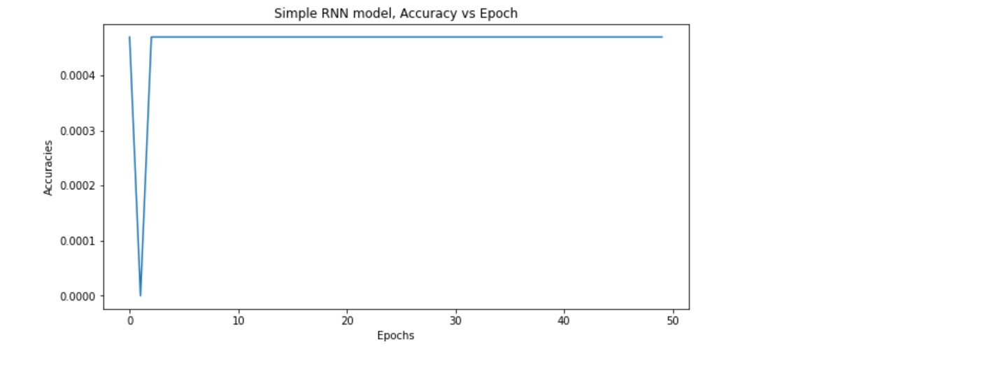
Results
The following graphs represent the losses that occur when the model is training

Slide 24
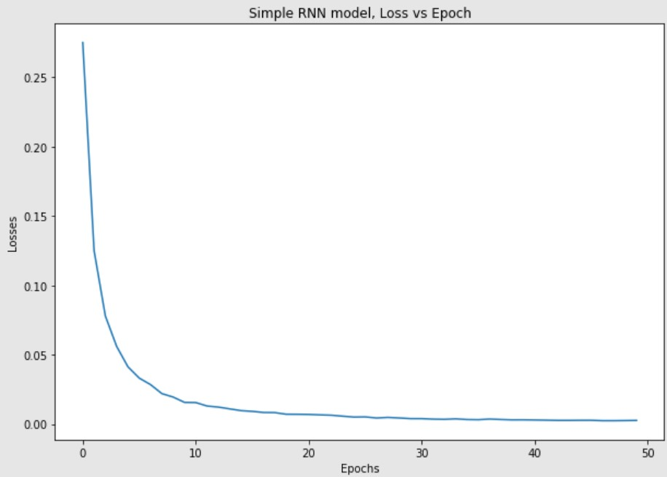

Slide 25
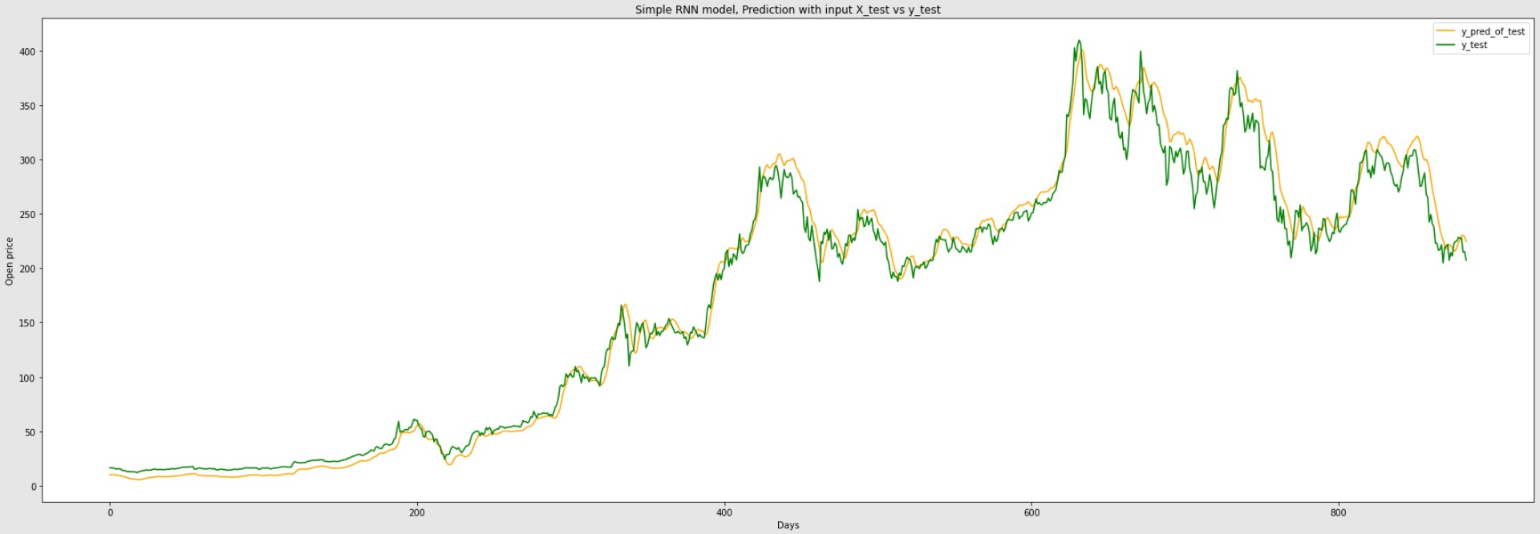
The

Slide 26
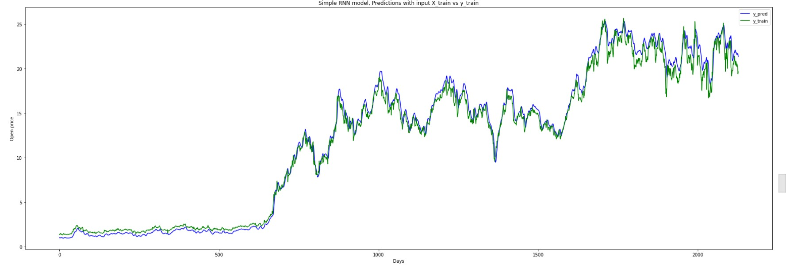

Slide 27
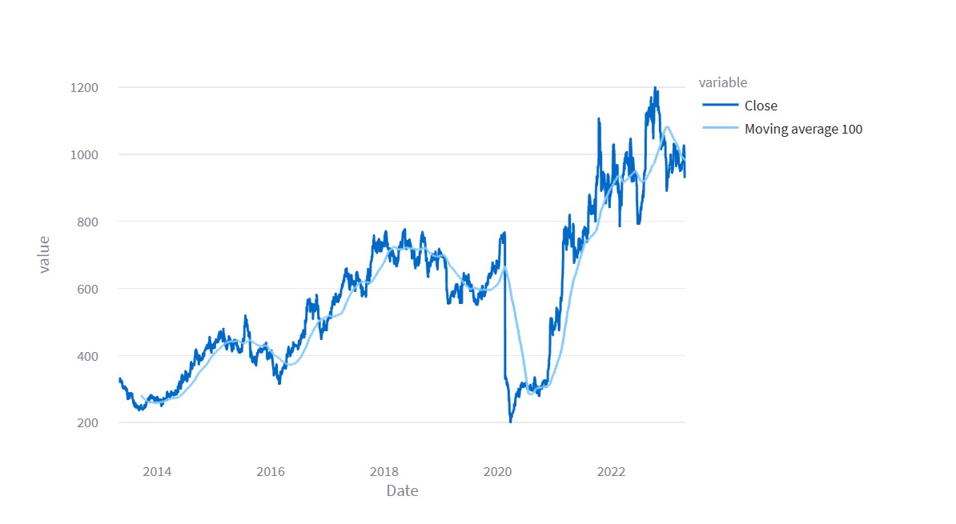
The below graph is the 100-day Moving Average vs Closing represented using plotly.js on a StockX

Slide 28
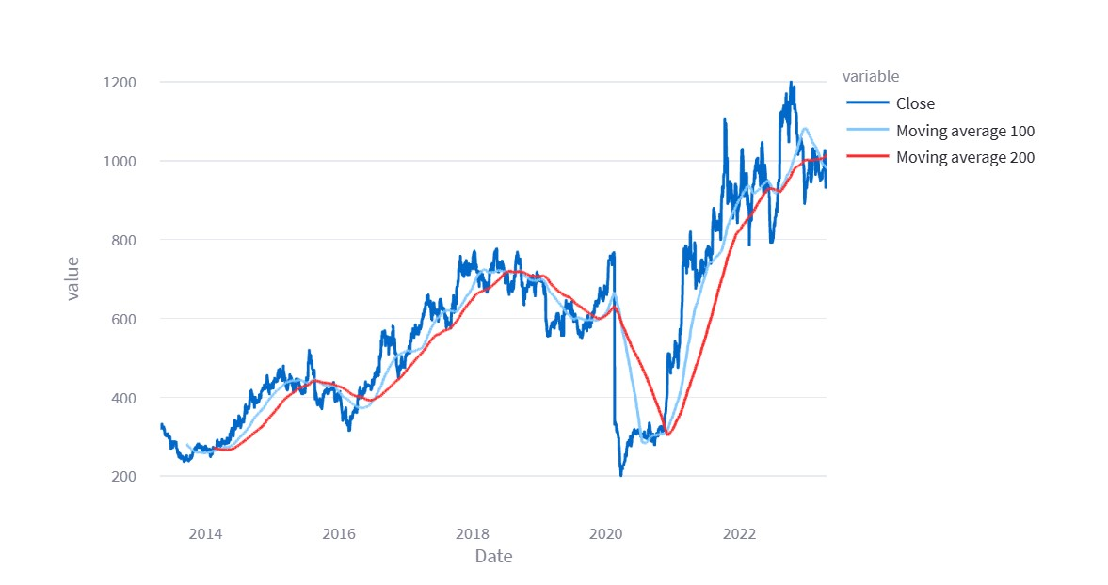
The below graph is the 200-day Moving Average vs Closing represented using plotly.js on StockX.

Slide 29
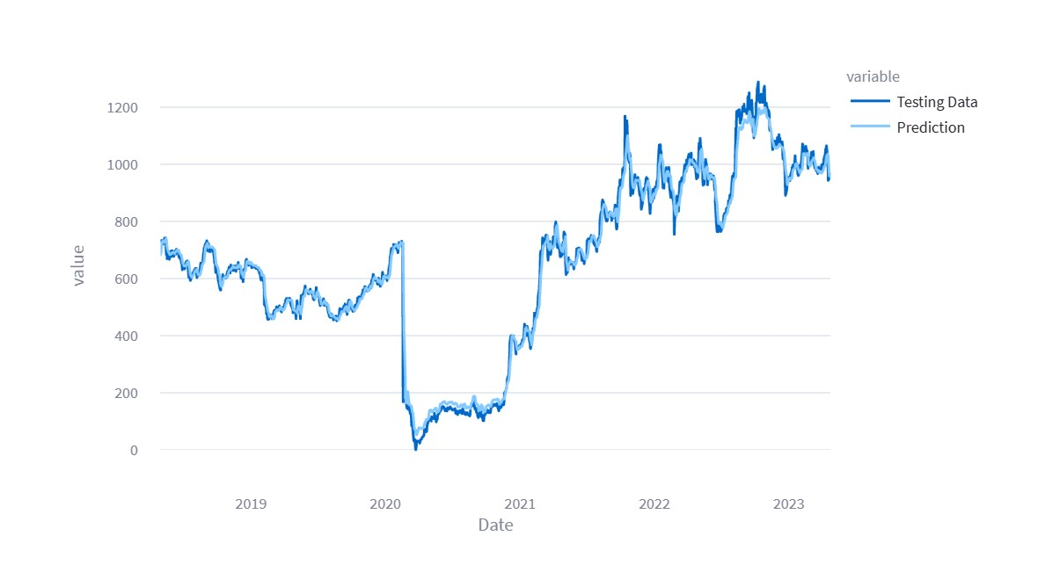
The below graph is the testing data vs prediction data represented using plotly.js on StockX.

Slide 30
Conclusion
Recurrent Neural Networks (RNNs), a type of neural network that can account for the sequential structure of data, are ideal for a variety of applications, including time series analysis, speech recognition, and natural language processing. They can handle input sequences of varying length because they can model time dependencies using feedback loops within the network. RNNs come in a variety of forms, such as the fundamental RNN, LSTM, and gated recurrent units. (GRUs). These modifications enhance the fundamental RNN architecture by tackling the vanishing gradient issue, which can have an impact on how deep networks are trained. Recent years have seen a rise in the use of Long Short-Term Memory (LSTM), a type of Recurrent Neural Network (RNN), for market price forecasting. The temporal and long-term dependencies present in finance time series data have been successfully captured by LSTMs.

Slide 31
The majority of the studies that used LSTMs for stock price forecasts outperformed conventional statistical models. The ability of LSTMs to manage noisy and non-linear data is another benefit. For stock price prediction in the presence of noise and non-linearities, LSTMs have been used in a number of experiments.LSTMs have some drawbacks that must be taken into account when using them to forecast stock prices despite their benefits. The inability to easily understand the findings is one drawback. LSTMs are frequently referred to as "black box" models, which makes it challenging to understand how they make forecasts. The sensitivity of LSTMs to hyperparameter choices is another drawback. The number of layers, the number of neurons in each layer, the learning rate, and the dropout rate are examples of hyperparameters, which are parameters specified before the model is trained. The selection of hyperparameters can have a significant impact on how well an LSTM model performs.

Slide 32
References
R. Gupta and M. Chen, "Sentiment Analysis for Stock Price Prediction," 2020 IEEE Conference on Multimedia Information Processing and Retrieval (MIPR), 2020, pp. 213-218, doi: 10.1109/MIPR49039.2020.00051.
B. N. Varaprasad, C. Kundan Kanth, G. Jeevan and Y. K. Chakravarti, "Stock Price Prediction using Machine Learning," 2022 International Conference on Electronics and Renewable Systems (ICEARS), 2022, pp. 1309-1313, doi: 10.1109/ICEARS53579.2022.9752248.
A. Maiti and P. Shetty D, "Indian Stock Market Prediction using Deep Learning," 2020 IEEE REGION 10 CONFERENCE (TENCON), 2020, pp. 1215-1220, doi: 10.1109/TENCON50793.2020.9293712.
R. Zhang, Z. Wu and S. Wang, "Prediction of Stock Based on Convolution Neural Network," 2020 Chinese Control And Decision Conference (CCDC), 2020, pp. 3175-3178, doi: 10.1109/CCDC49329.2020.9164222.
L. Sayavong, Z. Wu and S. Chalita, "Research on Stock Price Prediction Method Based on Convolutional Neural Network," 2019 International Conference on Virtual Reality and Intelligent Systems (ICVRIS), 2019, pp. 173-176, doi: 10.1109/ICVRIS.2019.00050.

Slide 33
Thank You

